Slide 1
Digital Logic Structures

Slide 2
Electrons
Are tiny
Are negatively charged
Hurt
Are the basis for our modern society

Slide 3
Circuits
A circuit is a path which allows electrons to flow.
A generator or battery provides the push to the electrons known as Voltage.
Pushing the electrons doesn’t mean they will move.
Electrons can only move if they have somewhere to move.
Think of pushing a line of people against a closed door. The people wont move no matter how hard you push.
Open the door and they all fall down.
When electrons move that is called Current.

Slide 4
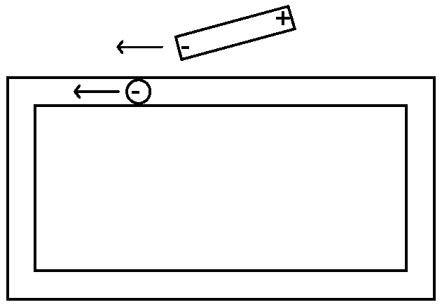
Magnets Move Electrons
The magnet, the electron, and the wire.

Slide 5
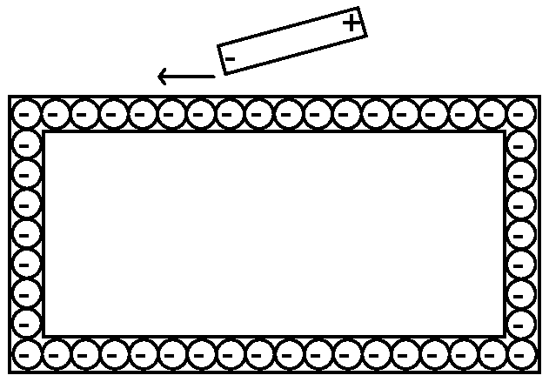
A wire is FULL of electrons.
Will this work? This is a complete circuit.
Think of it like a bicycle chain.
The moving magnet provides pressure or voltage.

Slide 6
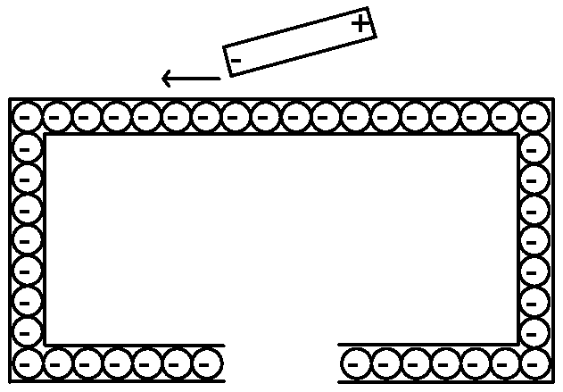
Open Circuit.
Electrons can't leave the wire (normally).
The pressure is still being applied (moving magnet).
Voltage is present even if current is not flowing.

Slide 7
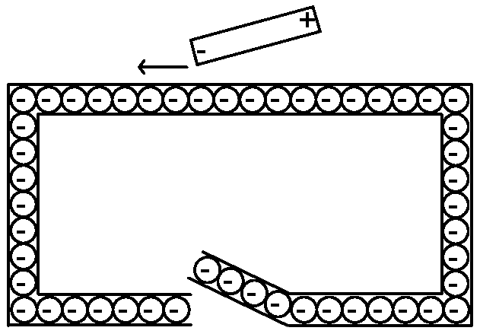
The Switch
If the pressure (voltage) is there …
closing the switch lets electrons flow (current).

Slide 8
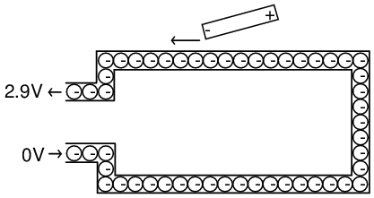
Source and Ground
One side supplies electrons = 2.9V = 1
One side provides path back = ground = 0

Slide 9
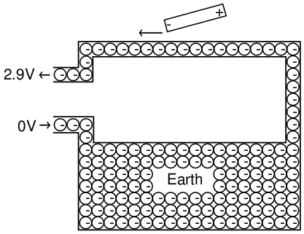
Why Ground?
One side (the return side) is sometimes connected to the actual ground.
The electrical system in your home is ALWAYS connected to earth this way.

Slide 10
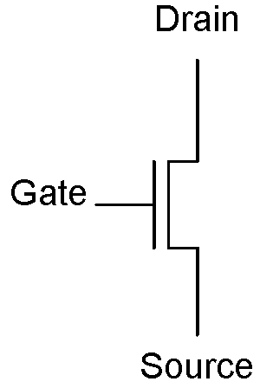
Transistors
A transistor is like an electronic switch.
Metal Oxide Semiconductor (MOS)
The GATE is the control.
1 = on = closed = conducting
0 = off = open = not conducting

Slide 11
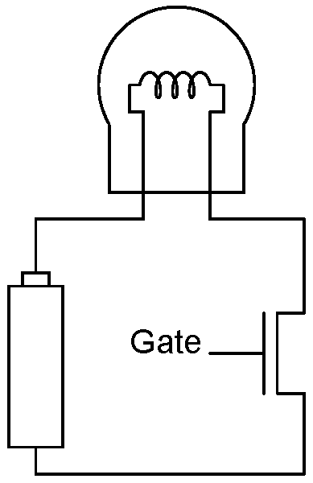
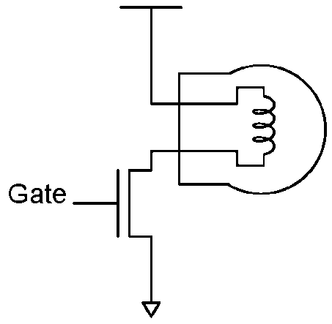
Light Circuit with Transistor
1 on Gate turns transistor "on".
Transistor "on" means a complete path.
A complete path means current flow.
Current flow means light.

Slide 12
Electrons Move Easily
The electrons here move TOO easily.
If there is nothing to slow the electrons down the material quickly overheats and will probably melt.
You MUST always have some sort of resistance to current flow to prevent this

Slide 13
Important Points
A transistor is a switch that can be considered open or closed.
Voltage levels, not current, represent 1s and 0s.
1 is usually some positive voltage and 0 is a connection to ground or zero voltage.
Voltage is present without current flow.
You must always have some resistance in a circuit to prevent excessive heat.

Slide 14

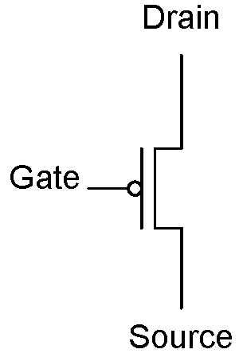
n-type or p-type
n-type requires 1 to conduct
p-type requires 0 to conduct
n-type p-type

Slide 15
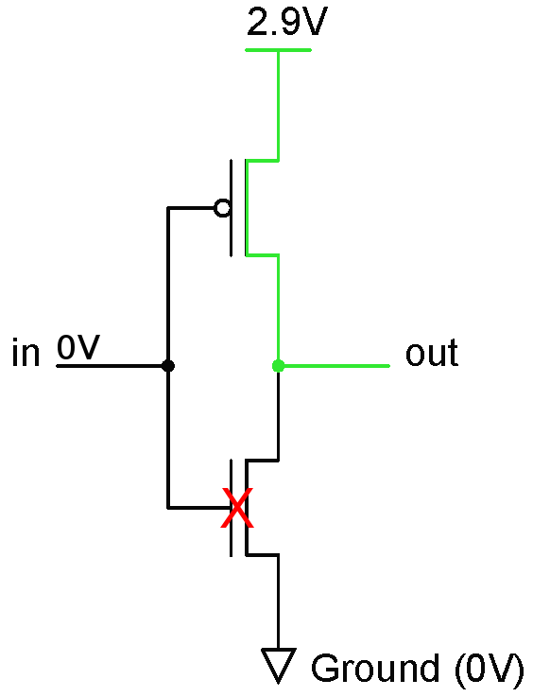
Building Circuits 1
in | out
0
1
We are trying to either connect voltage (1) or ground (0) to the output.

Slide 16
Building Circuits 2
in | out
0 | 1
1

Slide 17
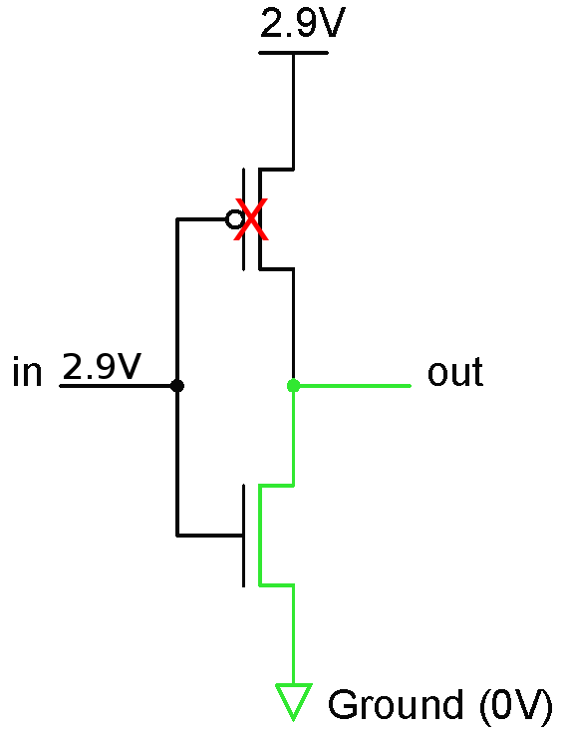
Building Circuits 3
in | out
0 | 1
1

Slide 18
Building Circuits 4
in | out
0 | 1
1 | 0

Slide 19
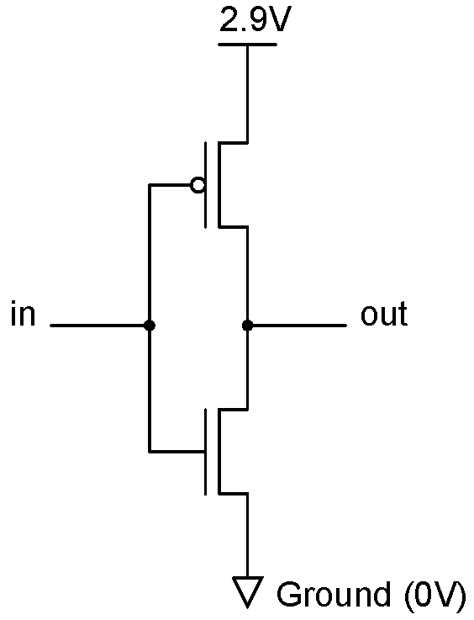
CMOS Inverter
Complementary because it has both n-type and p-type
in | out
0 | 1
1 | 0

Slide 20
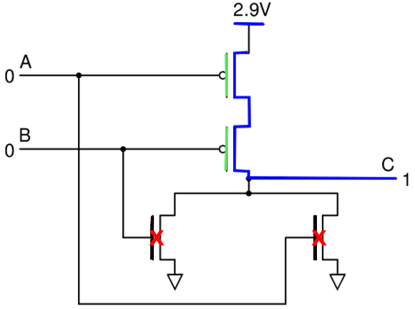
Fill in the truth table
A | B | C
0 | 0 | ?
0 | 1
1 | 0
1 | 1

Slide 21
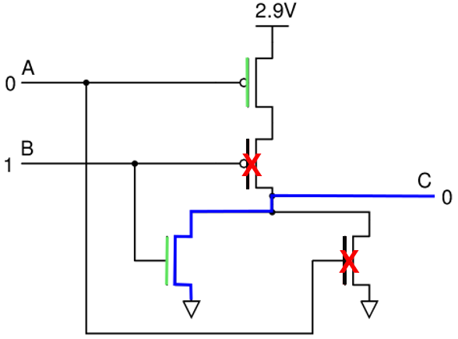
Fill in the truth table 1
A | B | C
0 | 0 | 1
0 | 1 | ?
1 | 0 | ?
1 | 1

Slide 22
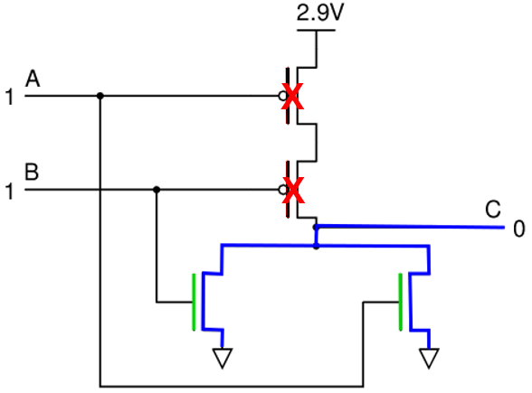
Fill in the truth table 2
A | B | C
0 | 0 | 1
0 | 1 | 0
1 | 0 | 0
1 | 1 | ?
These circuits are designed so that either 1 or 0 is ALWAYS connected to the
output and so that 1 and 0 are never connected at the same time.

Slide 23
Fill in the truth table 3
A | B | C
0 | 0 | 1
0 | 1 | 0
1 | 0 | 0
1 | 1 | 0
So, what is it?

Slide 24
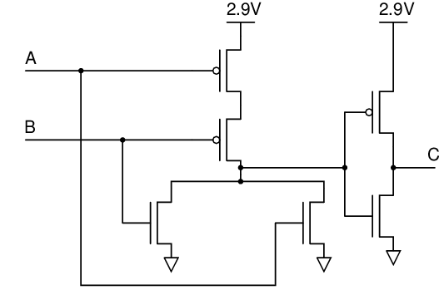
Fill in the truth table 4
A | B | C
0 | 0
0 | 1
1 | 0
1 | 1
What is this?

Slide 25
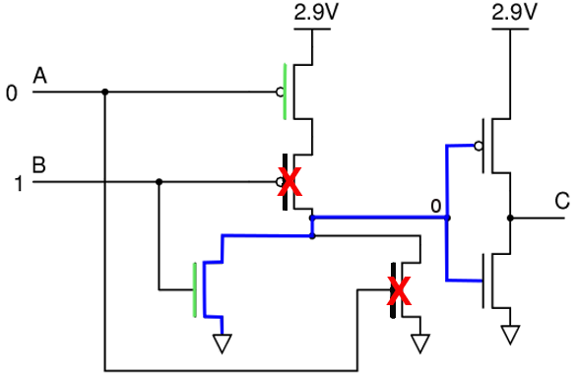
Fill in the truth table 5
A | B | C
0 | 0
0 | 1 | ?
1 | 0
1 | 1

Slide 26
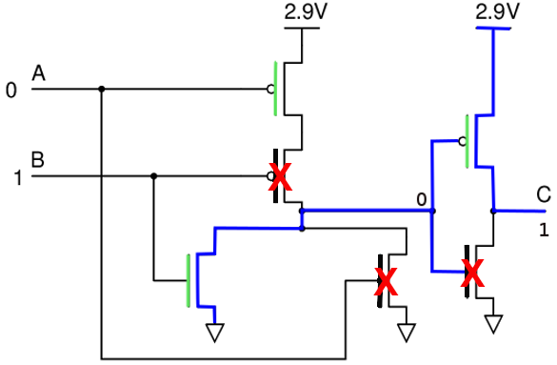
Fill in the truth table 6
A | B | C
0 | 0
0 | 1 | 1
1 | 0
1 | 1
What is this gate?

Slide 27
Fill in the truth table 7
A | B | C
0 | 0
0 | 1 | 1
1 | 0
1 | 1
What is this gate?

Slide 28
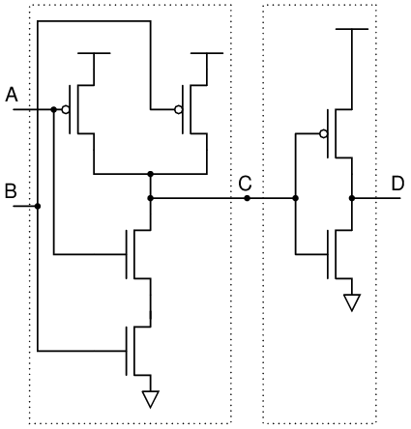
Fill in the truth table 8
A | B | C | D
0 | 0
0 | 1
1 | 0
1 | 1
What is this?

Slide 29
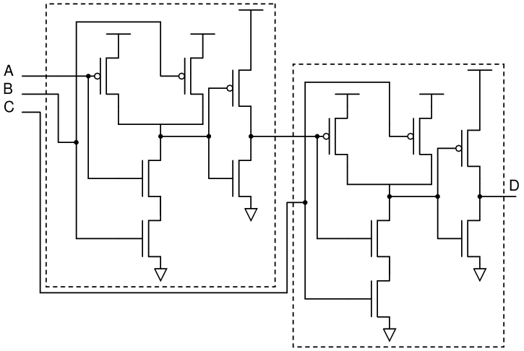
Three input AND

Slide 30

And Gate
And
The book uses the word and as the symbol
Logic uses ^
Other digital sources use * (as in multiplication)
Examples:
A and B A^B A*B AB
Electronic Symbol
A | B | A and B
0 | 0 | 0
0 | 1 | 0
1 | 0 | 0
1 | 1 | 1

Slide 31

Or Gate
Or
The book uses the word or as the symbol
Logic uses v
Other digital sources use + (as in addition)
Examples
A or B AvB A+B
Electronic Symbol
A | B | A or B
0 | 0 | 0
0 | 1 | 1
1 | 0 | 1
1 | 1 | 1

Slide 32

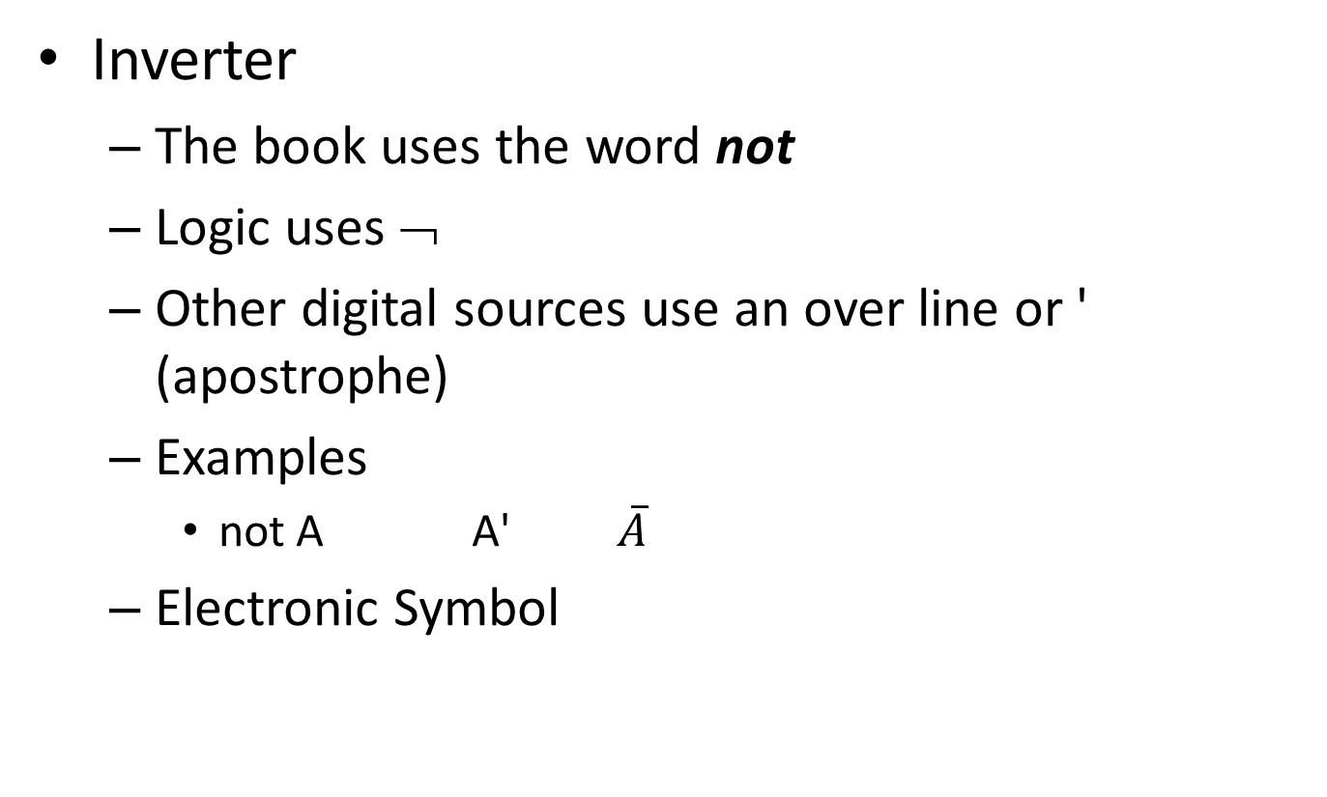
Inverter Gate
Inverter
The book uses the word not
Logic uses ¬
Other digital sources use an over line or ' (apostrophe)
Examples
not A A' $\overline{A}$
Electronic Symbol
A | not A
0 | 1
1 | 0

Slide 33

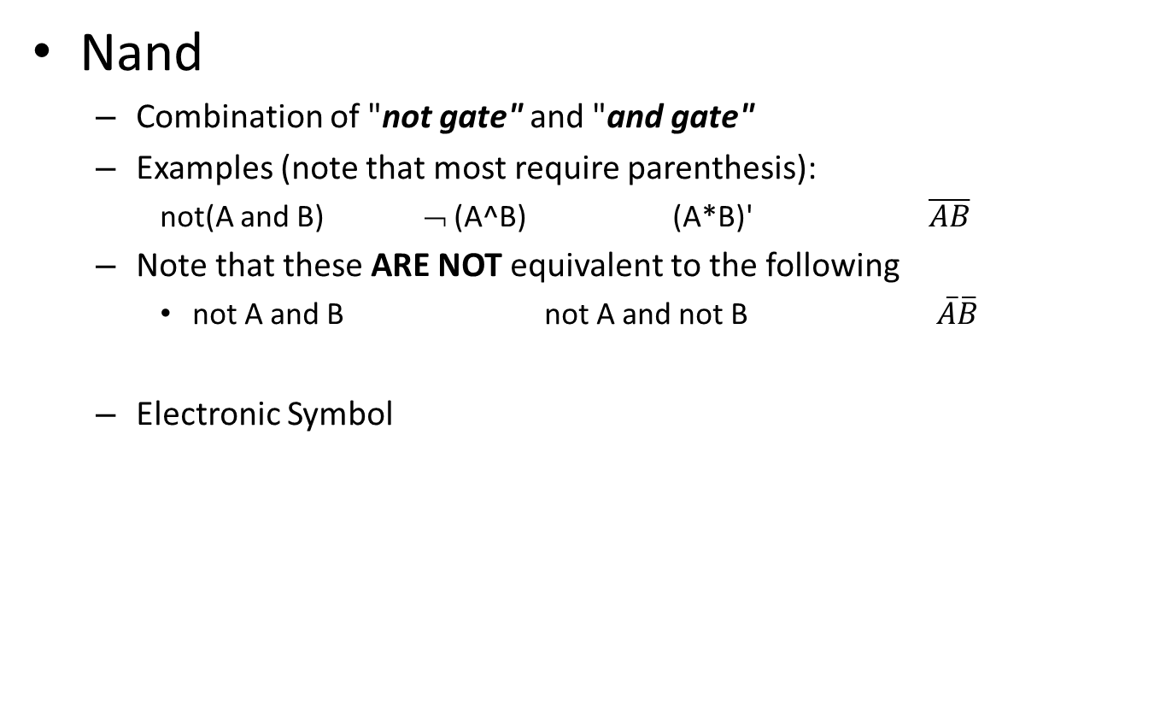
Nand Gate
Nand
Combination of "not gate" and "and gate"
Examples (note that most require parenthesis):
not(A and B) ¬ (A^B) (A*B)' $\overline{AB}$
Note that these ARE NOT equivalent to the following
not A and B not A and not B $\overline{A}\overline{B}$
Electronic Symbol
A | B | A and B | Not(A and B)
0 | 0 | 0 | 1
0 | 1 | 0 | 1
1 | 0 | 0 | 1
1 | 1 | 1 | 0

Slide 34

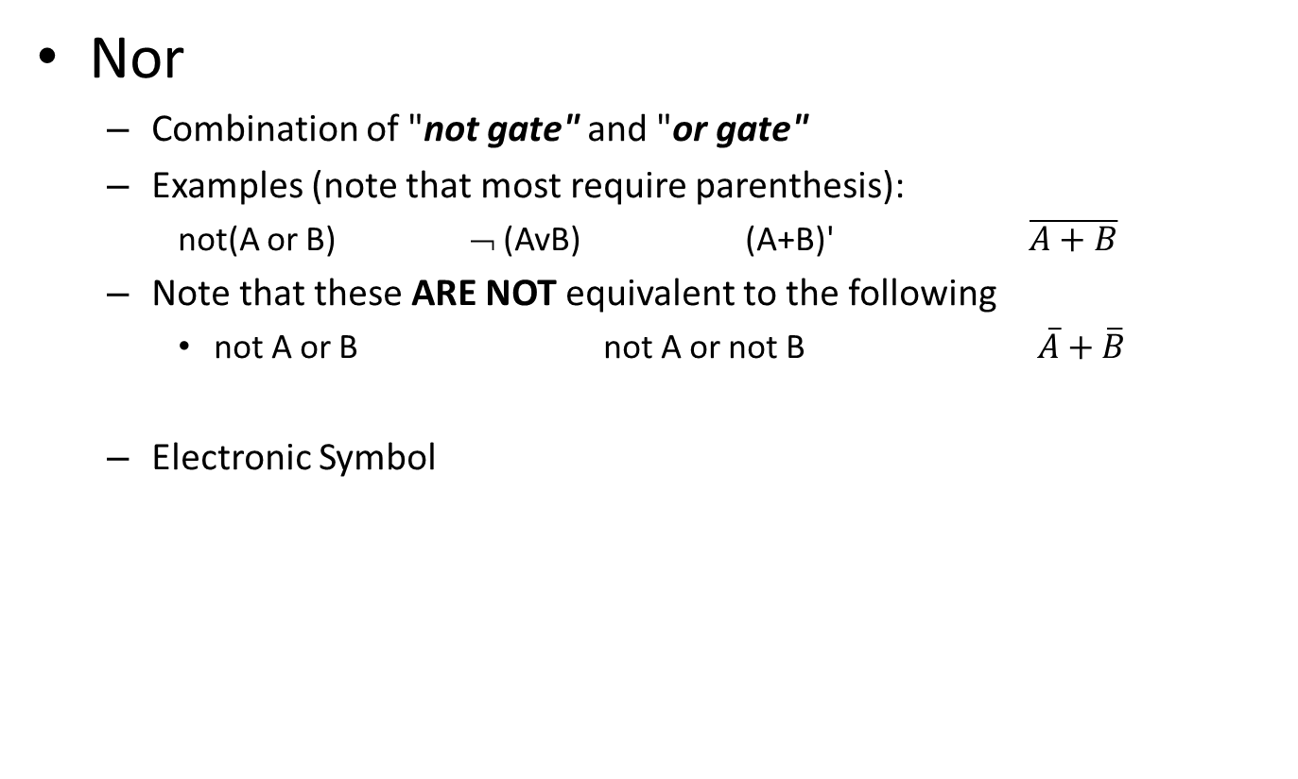
Nor Gate
Nor
Combination of "not gate" and "or gate"
Examples (note that most require parenthesis):
not(A or B) ¬ (AvB) (A+B)' $\overline{A+B}$
Note that these ARE NOT equivalent to the following
not A or B not A or not B $\overline{A}+\overline{B}$
Electronic Symbol
A | B | A or B | Not(A or B)
0 | 0 | 0 | 1
0 | 1 | 1 | 0
1 | 0 | 1 | 0
1 | 1 | 1 | 0

Slide 35


XOR - XNOR
A | B | A ^ B |  | A | B | (A ^ B)'
0 | 0 | 0 |  | 0 | 0 | 1
0 | 1 | 1 |  | 0 | 1 | 0
1 | 0 | 1 |  | 1 | 0 | 0
1 | 1 | 0 |  | 1 | 1 | 1
Exclusive OR (XOR) means A or B but not both.
$$A⊕B=\overline{A}B+A\overline{B}$$

Slide 36


N-Input Gates
The gates shown with two inputs can have multiple input versions.
The internals are more complicated, but the result is the same.
And gates will have an output of 0 if any of the inputs are 0.
Or gates will have an output of 1 if any of the inputs are 1.
Three input examples:
And Or

Slide 37
DeMorgan's Laws
You can use DeMorgan's Law to say the same thing in a different way.
DeMorgan
not ( p or q ) is the same as not p and not q
not ( p and q ) is the same as not p or not q
A phrase with a negation can be rewritten using DeMorgan
I do not speak either Spanish or German
I do not speak Spanish and I do not speak German
I do not drink and drive
I do not drink or I do not drive

Slide 38


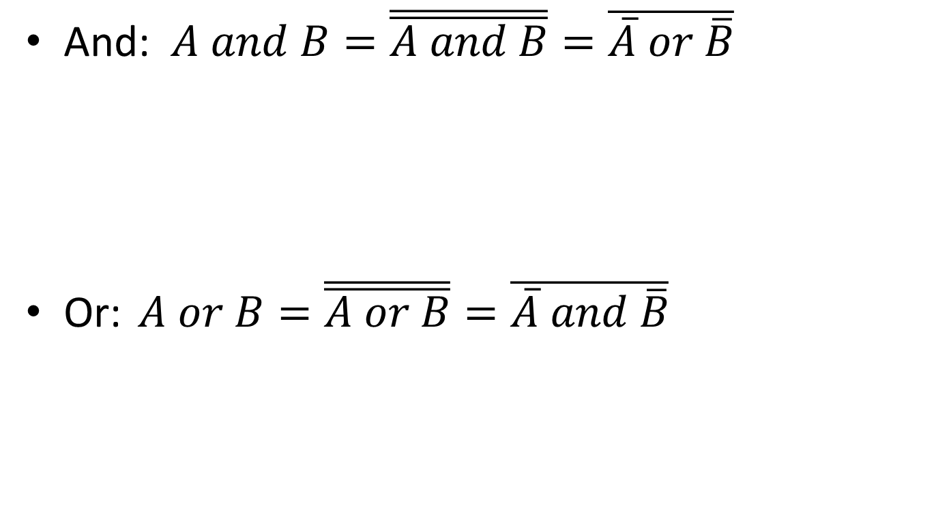
DeMorgan Version of Gates
And: $A and B=\overline{\overline{A and B}}=\overline{\overline{A} or \overline{B}}$
Or: $A or B=\overline{\overline{A or B}}=\overline{\overline{A} and \overline{B}}$

Slide 39
Combination Circuits
Bigger circuits using gates to accomplish a specific task.
Often it isn't important to see the internal workings as long as you know what they are and how they work.
Decoder
Multiplexor
Adder
Counter

Slide 40
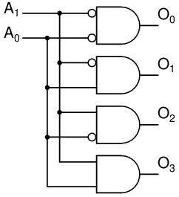
2 x 4 Decoder
Select a specific output pattern for each input pattern
Typically, a single output is 1 for a given input but others are possible (7 segment decoder).
Think of it as decoding a binary number.
This is a 2x4 decoder. Other sizes are common.

Slide 41
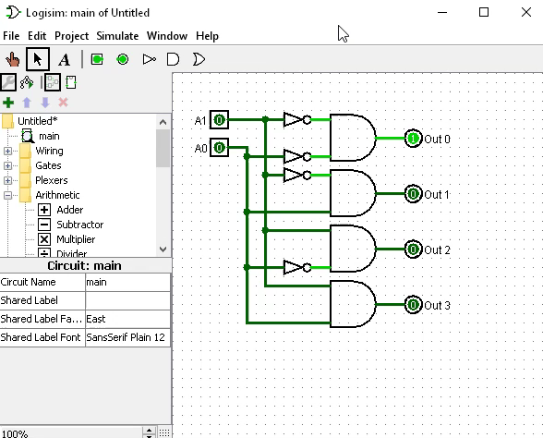
Logisim
Digital Logic Simulator
Written in Java
Works on any OS
4-bit Decoder
Click image to play video

Slide 42
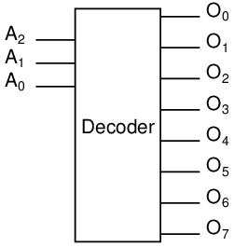
3 x 8 Decoder Block
Could you draw the internals?
Why 8 output lines?
What would require 16 output lines?
Assume 5 on input, what would the output be? What about 7?
Build a 3 to 8 decoder in Logisim tonight.

Slide 43
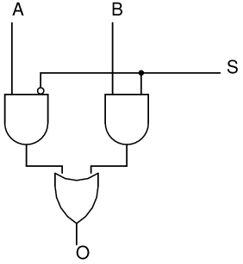
Multiplexer
A multiplexer (or mux) is a digital selector.
A multiplexer chooses one of several inputs to appear on an output.
More complex multiplexers consist of multiple single multiplexers working together.

Slide 44
Multiplexer Answer The Following
S is the select bit (or bits).
A and B are inputs.
The value of A or B will appear on the output according to the value on S.
A=0, B=0, S=0, O=____
A=0, B=1, S=0, O=____
A=0, B=1, S=1, O=____
A=1, B=0, S=0, O=____
A=1, B=0, S=1, O=____
A=1, B=1, S=1, O=____

Slide 45
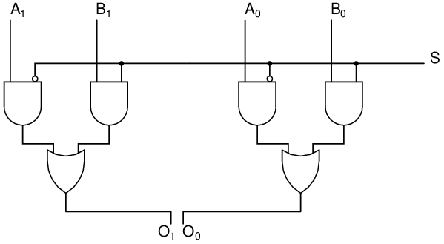
More Complex Mux 4x2
A = 3, B = 2, S = 0: What is O?
A = 1, B = 3, S = 1: What is O?

Slide 46
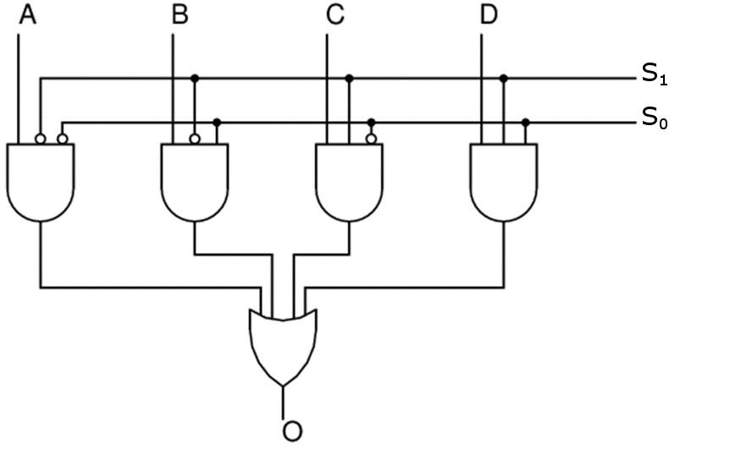
Another Complex Mux 4x1

Slide 47
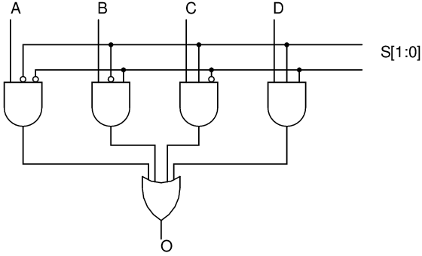
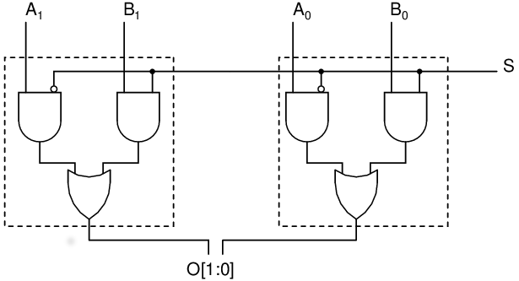
4x1 vs 4x2
Notice the difference

Slide 48
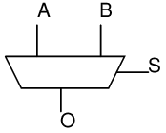
2x1 Block Diagram of a Mux

Slide 49
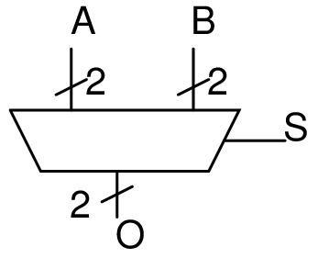
4x2 Block Diagram of a Mux

Slide 50
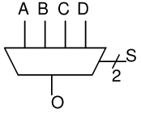
4x1 Block Diagram
Homework:
Build a 16x4 Multiplexer in Logisim

Slide 51
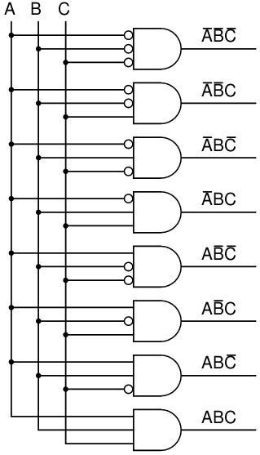
Decoder as a Universal Circuit
What is the output when A=0, B=0, and C=0?

Slide 52
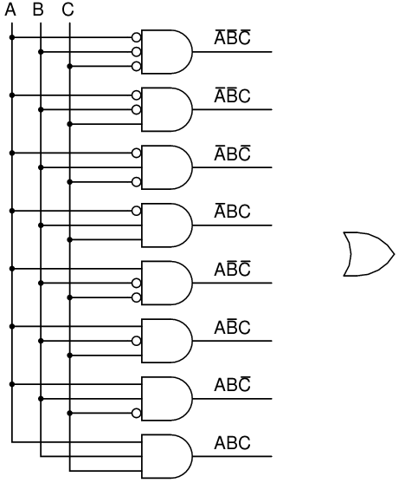

Decoder as a Universal Circuit Example
$f\left(A,B,C\right)=\overline{A}BC+ \overline{A}\overline{B}C+ABC$

Slide 53
Adding in Binary
Add A + B
 | 1 | 1 | 1 | 0 | <-Carry
 | 0 | 1 | 1 | 1 | A=7
+ | 0 | 0 | 1 | 1 | B=3
 | 1 | 0 | 1 | 0 | (10)
What is required to add one column?
One bit from A, One bit from B, and a carry in.
What is the output?
Sum and Carry out.

Slide 54
Truth table for adding one bit.
Cin | Bit From A | Bit from B | Sum | Cout
0 | 0 | 0
0 | 0 | 1
0 | 1 | 0
0 | 1 | 1
1 | 0 | 0
1 | 0 | 1
1 | 1 | 0
1 | 1 | 1

Slide 55
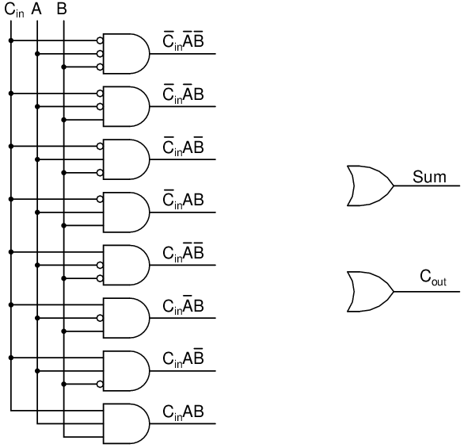
Create the circuit
C_{in} | A | B | Sum | C_{out}
0 | 0 | 0 | 0 | 0
0 | 0 | 1 | 1 | 0
0 | 1 | 0 | 1 | 0
0 | 1 | 1 | 0 | 1
1 | 0 | 0 | 1 | 0
1 | 0 | 1 | 0 | 1
1 | 1 | 0 | 0 | 1
1 | 1 | 1 | 1 | 1

Slide 56
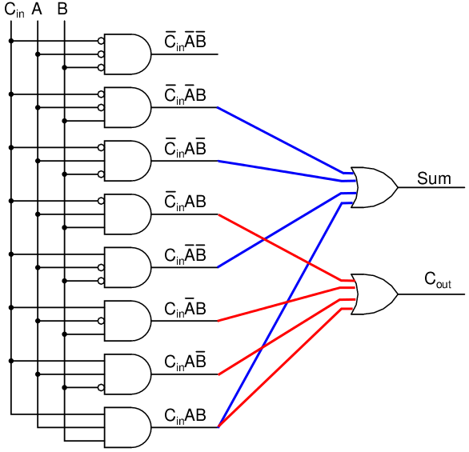
Adder

Slide 57
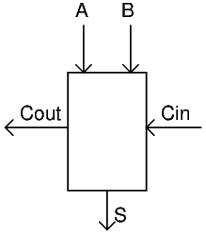
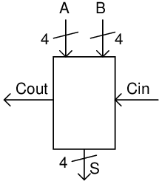
Adder Block Diagram
By creating a circuit for a single bit, it makes it easier to add
more bits by simply duplicating the adder circuit for each bit.

Slide 58
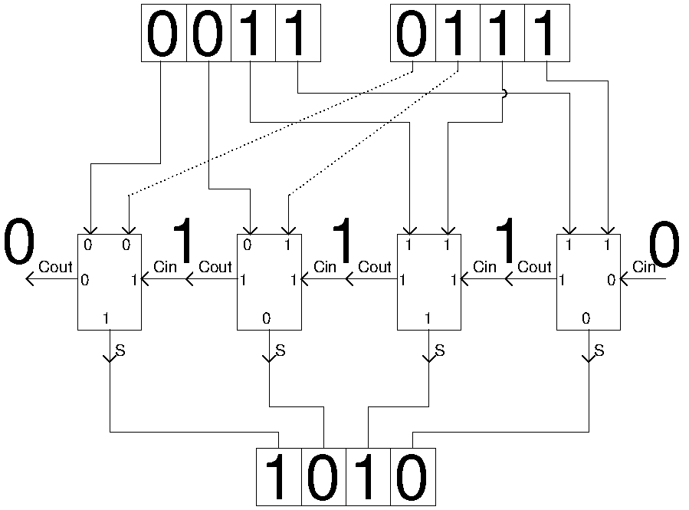
4-bit adder
Cin | B1 | B2 | Sum | Cout
0 | 0 | 0 | 0 | 0
0 | 0 | 1 | 1 | 0
0 | 1 | 0 | 1 | 0
0 | 1 | 1 | 0 | 1
1 | 0 | 0 | 1 | 0
1 | 0 | 1 | 0 | 1
1 | 1 | 0 | 0 | 1
1 | 1 | 1 | 1 | 1
Homework:
Build a 4-bit Adder in Logisim

Slide 59
Storing 1s and 0s
So far 1s and 0s have just appeared on inputs without explanation about where they come from.
For a computer to add it needs an adder circuit, but the inputs must be stored somewhere on the computer also.
The result, also, must get stored somewhere for it to be useful.
We store these bits in a circuit called a latch.

Slide 60
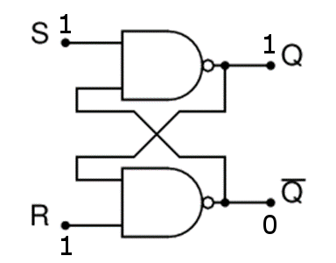
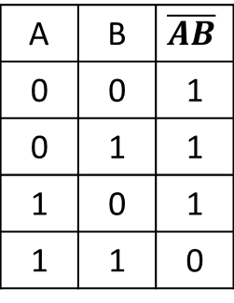
R-S Latch
NAND TRUTH TABLE
A | B | $$\overline{AB}$$
0 | 0 | 1
0 | 1 | 1
1 | 0 | 1
1 | 1 | 0

Slide 61
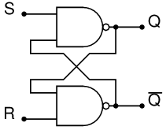
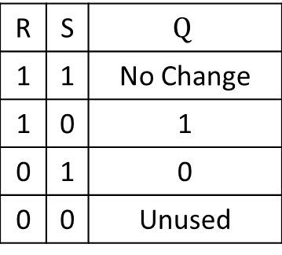
R-S Latch Excitation Table
R | S | $$Q$$
1 | 1 | No Change
1 | 0 | 1
0 | 1 | 0
0 | 0 | Unused
1 on S and R means Q doesn't change.
0 on S means set Q to 1
0 on R means reset Q to 0
Do not put 0 on S and R at same time.

Slide 62
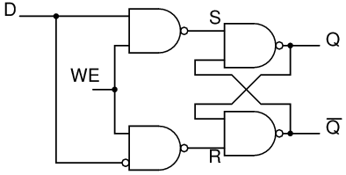
The Gated D Latch
A modified R-S latch.
A single input (D)
A write enable circuit (WE)
A gate circuit directs inputs to R and S.
D | WE | Q
0 | 0 | No Change
0 | 1 | 0
1 | 0 | No Change
1 | 1 | 1

Slide 63
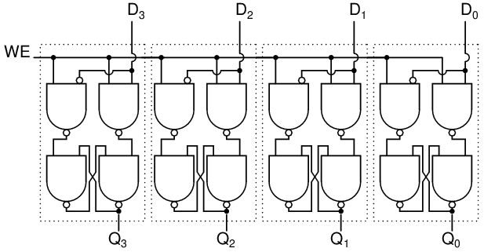
Storing More than One Bit
How could four bits be stored? Use four D latches working together.
The device for storing multiple bits as a unit is called a REGISTER.
Bigger numbers simply use more latches.
64-bit microprocessors use 64 latches for registers.

Slide 64
Register Annotation
The bits are labeled with subscripts from low order to high order which is typically right to left.
The instruction register (IR) is a 16 bit register
We can refer to ranges of bits using brackets
IR[15:12] = 1001
IR[7:0] = 01110110
IR₁₅ | IR₁₄ | IR₁₃ | IR₁₂ | IR₁₁ | IR₁₀ | IR₉ | IR₈ | IR₇ | IR₆ | IR₅ | IR₄ | IR₃ | IR₂ | IR₁ | IR₀
1 | 0 | 0 | 1 | 0 | 1 | 0 | 0 | 0 | 1 | 1 | 1 | 0 | 1 | 1 | 0

Slide 65
More Register Annotation
R1 <- R2 + R3
R1 <- R2 + 0
R1 <- R1 and 0
R1 <- not R1
R1 <- R1 + 1
R1 <- R1 + R2
MDR <- MEM[MAR]
IR <- MDR
What do these do?
What do these do?

Slide 66
Sequential Logic Circuits
The circuits we studied before are called Combinational Logic.
Combinational Logic takes some inputs and determines the output by tracing the gate outputs from start to finish.
Sequential Logic specifies an ordered sequence of outputs. For the sequence to be ordered the circuit must somehow "know" the last set of outputs.
Sequential logic has memory units (latches) and those memory units provide input to determine the next sequence or state.

Slide 67

Sequential Logic Block Diagram
Contains a combinational portion as well as some storage elements for keeping track of the current state.

Slide 68

State Diagram With Input
Let's count from 0 to 3 in binary and repeat
00 -> 01 -> 10 -> 11 -> 00 -> 01 -> 10 -> 11 -> …
This is a simple state diagram.

Slide 69
Finite State Machine
A machine to generate all possible states and consists of:
a finite number of states
a finite number in external inputs
a finite number of external outputs
an explicit specification of all state transitions
an explicit specification of what determines an output

Slide 70
Combination Lock Example
Four states
A – Incorrect turns – lock not open
B – Correct first turn - lock not open
C – Correct second turn - lock not open
D – Correct third turn - lock open
The combination is R13, L22, R3
The internals of the lock represent the memory in the positioning of the opening mechanism.

Slide 71

Combination Lock State Diagram
Are we done? Are all transitions labeled?

Slide 72

Combination Lock State Diagram Complete
We must show ALL transitions.
This is much more complicated than before.

Slide 73
Example 2-bit patterns
2 bits can form four states. They won't necessarily be in order.
1 switch input (0=count, 1=pause).
Build a count up circuit with pause.
Draw the state diagram.
Create a truth table showing next states.
Build the circuit for each latch input

Slide 74

State Diagram Rules
Each state must have a transition of 1 and a transition of 0 OUT of the state.
Each state is a pair of D latches with the output connected to LEDs.
State 00 represents a zero in both latches with both LEDs being off.
State 11 represents a 1 in both latches with both LEDs being on.
State 01 and 10 represent a zero in one latch and a zero in the other. One of the LEDs will be on. The other LED will be off.

Slide 75

Latches and States Example 1
Q1=0 Q0=0 Sw=0
What do we need for proper state transition?

Slide 76
Latches and States Example 2
Q1=1 Q0=0 Sw=1
What do we need on D1 and D0 for proper state transition?

Slide 77
Count up with pause
Q1 and Q0 are the current state.
D1 and D0 are the next state.
The switch Sw represent the transition.
Q1 | Q0 | SW | D1 | D0
0 | 0 | 0
0 | 0 | 1
0 | 1 | 0
0 | 1 | 1
1 | 0 | 0
1 | 0 | 1
1 | 1 | 0
1 | 1 | 1

Slide 78

Count up with pause fill in table
Q1 and Q0 are the current state.
D1 and D0 are the next state.
The switch Sw represent the transition.
Q1 | Q0 | SW | D1 | D0
0 | 0 | 0 | 0 | 1
0 | 0 | 1
0 | 1 | 0
0 | 1 | 1
1 | 0 | 0
1 | 0 | 1
1 | 1 | 0
1 | 1 | 1

Slide 79

Count up with pause complete
Q1 and Q0 are the current state.
D1 and D0 are the next state.
The switch Sw represent the transition.
Q1 (A) | Q0 (B) | SW (C) | D1 (Out1) | D0 (Out 2)
0 | 0 | 0 | 0 | 1
0 | 0 | 1 | 0 | 0
0 | 1 | 0 | 1 | 0
0 | 1 | 1 | 0 | 1
1 | 0 | 0 | 1 | 1
1 | 0 | 1 | 1 | 0
1 | 1 | 0 | 0 | 0
1 | 1 | 1 | 1 | 1

Slide 80

Count up with pause wired
$$D1=\overline{A}B\overline{C}+A\overline{B}\overline{C}+A\overline{B}C+ABC \left(solid lines\right)$$
$$D0=\overline{A}\overline{B}\overline{C}+\overline{A}BC+A\overline{B}\overline{C}+ABC \left(dotted lines\right)$$

Slide 81

Completed Circuit

Slide 82
Other Circuits
Good test questions.
Count up and repeat
00 - 01 - 10 - 11 - 00 - 01 - …
Count up and stop at 11
Count down and repeat
11 - 10 - 01 - 00 - 11 - 10 - …
Count down and stop at 00
Both on – both off
00 -11 - 00 - 11 -…
Alternate
01 - 10 - 01 - 10 - …
Pause, remain in current state.
others …
Could do any of the above on sw = 0 and any other on sw = 1

Slide 83
Memory
There is a need to use more than one number in a computer.
Memory gives the ability to store and retrieve many numbers.
Write to memory
Must provide the data to store.
Must provide the address to store it in.
Must tell the memory to write and not read.
Reading from memory
Must provide the address to read.
Must tell the memory to read and not write.
Think of it as multiple registers working together. All that is needed is a way to pick out the correct register and determine read or write.

Slide 84

Memory Circuit

Slide 85

Writing
Write the number 5 to address 2.

Slide 86

0101 Stored in Address 2

Slide 87

Reading
Read value stored in address 3

Slide 88
Memory Circuit Again

Slide 89

Memory Block
Addressability - How big are the data units?
Address Space - How many data units are there?

Slide 90

ALU

Slide 91
Problem?
There is a bit of a problem with using the D-Latch as shown with the clock.
The output changes, which changes the inputs, which will change the output, etc.. as long as the clock is high.
Use a master slave flip-flop to prevent the problem.

Slide 92

Master – Slave Flip-flop
First is set when clock goes high.
Second is set from first when clock goes low.
When clock is low, first can't be modified.

